Slide 1

SCSA1402-COMPUTER ARCHITECTURE AND ORGANIZATION
UNIT III MEMORY ORGANIZATION

Slide 2
COURSE OUTCOMES
CO1 - Classify the various types of registers, microinstructions
and addressing modes.
CO2 - Design the data path for processor.
CO3 - Demonstrate the usage of Memory Organization.
CO4 - Describe about the I/O devices.
CO5 - Explain the characteristics, structure, communication and
synchronization of multiprocessor.
CO6 - State the inter processor communication and
synchronization.

Slide 3

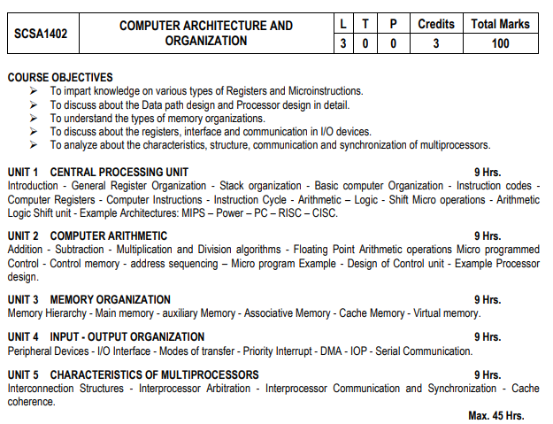

Slide 4
TEXT / REFERENCE BOOKS
1. M.Morris Mano, “Computer system Architecture”, 3rd Edition, Prentice-Hall
Publishers, 2007.
2. Mark Burrell, “Fundamentals of Computer Architecture”, Mcmillan Higher Education,
2003.
3. John D. Carpinelli, “Computer Systems Organization and Architecture”, Pearson
Education, 2001.
4. Carl Hamacher, Zvonko Vranesic and Safwat Zaky, “Computer Organization”, 5 th
Edition, McGraw-Hill, 2002.
5. William Stallings, “Computer Organization and Architecture - Designing for
Performance”, 9 th Edition, Prentice Hall, 2012.
6. John P Hayes, Computer Architecture Organization, McGraw Hill Edition 4, 2003.

Slide 5
MEMORY: Holds INSTRUCTIONS & DATA that we are interested in processing NOW.
ARRANGEMENT
Each is called a memory cell or a memory location.
Each cell is identified by a unique binary address.
Each cell contains a certain number of bits (usually eight).
Similar to what in a spreadsheet
# 0000 0000
1 1 1 1 0 0 0 0
# 0000 0001
0 1 1 0 0 1 0 1
# 0000 0010
0 1 0 1 0 0 1 1
# 0000 0011
1 0 0 1 1 0 0 1
# 0000 0100
1 1 0 0 1 1 0 0
...

Slide 6
MEMORY ADDRESSING
Just as Excel uses a cell reference in a formula to locate a cell and to read the data stored in that cell, a program uses a memory address.
So a memory cell address is similar to a spreadsheet’s absolute cell reference .
The cell contents can change, but the cell address or reference to the cell is always the same.
A program can write to and read from a memory cell through their address.
CPU
memory
LOAD #0000 0011 A
Register A
ADD A 1
# 0000 0011
0 1 0 1 0 0 1 0
_ _ _ _ _ _ _ _
1
0 1 0 1 0 0 1 0
STORE A #0000 0011
1

Slide 7
MEMORY ADDRESSING CONTD.
One memory cell:
Logical structure of 1 memory cell: 8 bits
Physical structure of 1 memory cell: 8 capacitors
#0000 0001
0 1 0 0 0 0 0 1
“32-bit memory-addressing” means that the computer uses memory addresses that are 32 bits long:
the “address bus” are the wires that carry bits between the CPU and the memory
a 32-bit bus carries 32 bits at a time
2³²  4 GB (billion)
different addressable memory cells.
Total primary memory and auxiliary storage in one’s computer is measured in bytes.
Kilobyte (KB or K): ~ 1 thousand 2¹⁰
Megabyte (MB): ~ 1 million 2²⁰
Gigabyte (GB): ~ 1 billion 2³⁰
Terabyte (TB): ~ 1 trillion 2⁴⁰

Slide 8
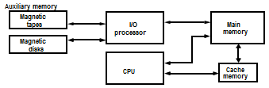
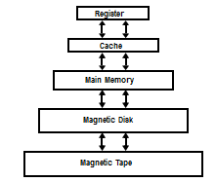
MEMORY HIERARCHY
Main Memory
Auxiliary Memory
Associative Memory
Cache Memory
Virtual Memory
The total memory capacity of a computer can be visualized as a hierarchy of components
Memory Hierarchy is to obtain the highest possible access speed while minimizing the total cost of the memory system

Slide 9
MEMORY HIERARCHY CONTD.
Main Memory is a memory unit that communicates directly with the CPU
Auxiliary Memory are those memory devices that provide backup storage. (EX) Magnetic discs and tapes. They are used for storing programs, large data files, etc.
Only programs and data are stored in main memory. All other information are stored in auxiliary memory and they are transferred to main memory whenever required.
At the hierarchy, magnetic tapes that are slow are used to store removable files.
Main memory occupies the central position being able to communicate directly with the CPU and with auxiliary memory through an I/0 Processor.
Cache memory is a very special very high speed memory used to increase the speed of processing by making current programs and data available to the CPU at a rapid rate
Cache memory is employed in a computer system to compensate the speed differential between main memory access time and processor logic.
CPU logic is quite faster than main memory, so in order to compensate for mismatch in operating speeds, it is to employ an extremely fast, small cache between the CPU and main memory.

Slide 10
MEMORY HIERARCHY CONTD.
Cache stores segments of program currently being executed in the CPU.
The I/O processor manages data transfer between auxiliary memory and main memory.
As the storage capacity of the memory increases, the cost per bit for storing binary information decreases and the access time of the memory becomes longer.
The auxiliary memory has a large capacity storage relatively inexpensive, but has low access speed compared to main memory.
The cache is very small relatively expensive and has very high access speed.
Goal of memory hierarch is to get highest possible average access speed while minimizing the total cost of the entire memory system.
The cache memory has an access time of 100ns while main memory has access time of 700ns.
Many operating systems are designed to enable CPU to process a number of independent programs concurrently. This concept is called multiprogramming, refers to the existence of two or more programs in different parts of memory hierarchy at the same time.
This procedure keeps parts of computer busy working with several programs in sequence.
The part of computer system that supervise the flow of information between the auxiliary memory and main memory is called the memory management system.

Slide 11
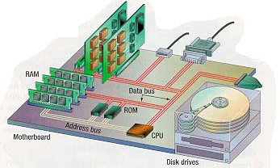
MEMORY HIERARCHY CONTD.

Slide 12

STORAGE
Computers basically have two-level storage:
Primary storage : MEMORY (chips)
Secondary/Auxiliary storage : STORAGE (disks…)
Processor
CU ALU
Inputs
Outputs
Memory
RAM ROM
Storage

Slide 13
TYPES OF PRIMARY MEMORY
RAM: Random Access Memory
RAM is fast.
Virtually no speed penalty for accessing bits, no matter which cell they’re in: “Random access”
RAM is writable (by the user). (launch; load; edit…)
RAM is volatile.
Often called “user memory” --
Typically 256 or 512 MB (and up) for personal computers.
Advice: Buy as much as you can afford.
Affects overall speed of system (page faults, caching)

Slide 14
TYPES OF PRIMARY MEMORY CONTD.
ROM (read-only memory)
Contents pre-written and permanent: non-volatile.
Typically small: <1 MB
Stores bootstrap program.
Stores BIOS (very basic parts of the operating system that rarely change are hardwired in ROM)
Often called: Firmware.
Other flavors of nonvolatile primary memory: PROM; EPROM; EEPROM
Flash Drives
CMOS (battery-powered)
“Virtual Memory”
○ use disk space to simulate RAM

Slide 15
AUXILIARY STORAGE
Want more memory than is affordable in electronic memory.
Cheaper: shares one set of electronics for R and W (the head).
But much slower: at least by 10,000 times.
Physically moves medium past R/W mechanism.
Need non-volatile storage that is recordable.
Primary memory:
Access is frequent and fast; but less is taken at a time
(4 - 8 bytes).
Secondary storage:
Access is less frequent and much slower; but a whole block of data is taken at a time. (256 - 1024 bytes)

Slide 16
MAGNETIC STORAGE
Most common form of storage.
Magnetized spots on a surface, which may be
on a tape, which itself moves past a R/W head (like audio tape)
on a disk, whose R/W head moves over it as it spins.
A disk may be floppy or rigid
A disk may be fixed permanently in the drive or removable.

Slide 17
MAGNETIC STORAGE CONTD.
Working of Magnetic recording
The resulting magnetic field can be in one of two different orientations (polarities):
A moving electrical charge (current) creates a magnetic field...
North-South (clockwise)
depending on the
direction that
the current flows
South-North
(counter-clockwise)
“INDUCTION”

Slide 18
MAGNETIC STORAGE CONTD.
We can send a current through a wire (the R/W mechanism) to magnetize a spot on an iron surface nearby.
The spot (with magnetic field around it) will have one of two orientations.
This way the head records (writes) physical representations of 0s and 1s on the iron surface.

Slide 19
MAGNETIC STORAGE CONTD.
If there’s a wire coil nearby, the current is sent through it in one of two different directions
The READ head interprets the direction of the incoming current as a 0 or a 1.

Slide 20
MAGNETIC TAPE
Ribbon coated with iron oxide
Sequential Access storage device:
to reach data written at the end need to go through all other data
Generally used for:
short-term backup
transport
Tape head
0
1
1
1
0
1
0
0
0
TAPE

Slide 21
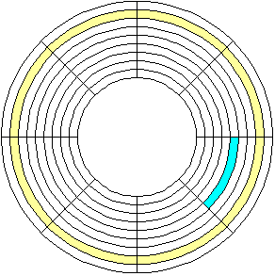
MAGNETIC DISKS
Track 0
Sec 6
Track 1
Track 2
Sec 5
Surface divided into wedges: sectors.
Bits are stored within a sector along concentric circles called tracks. (Floppy disk: ~80 tracks)
Sec 0
Sec 4
Sec 1
Sec 3
Sec 2
All disk drives are “DASDs”:
Direct Access Storage Devices
File is accessed directly by giving the address of each block on the disk that contains the file.
Similar to random access except it has speed penalties.
DIGRESSION: Speed…. SEEK time, SPIN rate

Slide 22
MAGNETIC DISKS CONTD.
Floppy disks (diskette) and drives
Transportable storage.
Good to back-up a few files.
Flexible plastic mylar …; removable media
Slow spin rates (360 to 400 rpm)
Slow seek time (~300 ms)
R/W heads touch disk surface
Cheap, abundant, portable

Slide 23
HARD DISKS/DISK DRIVES (FIXED)
Rigid aluminum or glass; various sizes; >1 platter
Much faster spin rates (currently up to 10,000 rpm)
Much faster access speeds (seek time = 5 – 15 ms)
Much faster transfer rates (15 MB/sec and up)
Fixed means: media NOT removable from the hardware
Internal and external
Capacities:
for older PC systems: 20 MB...80 MB...200 MB
Today: 20-500 GB and up

Slide 24
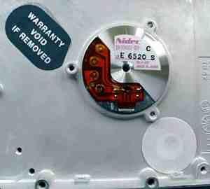
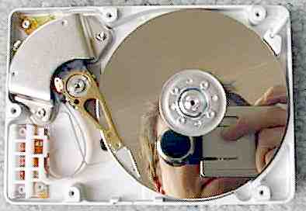
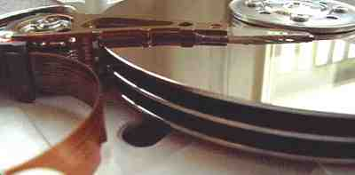

Slide 25
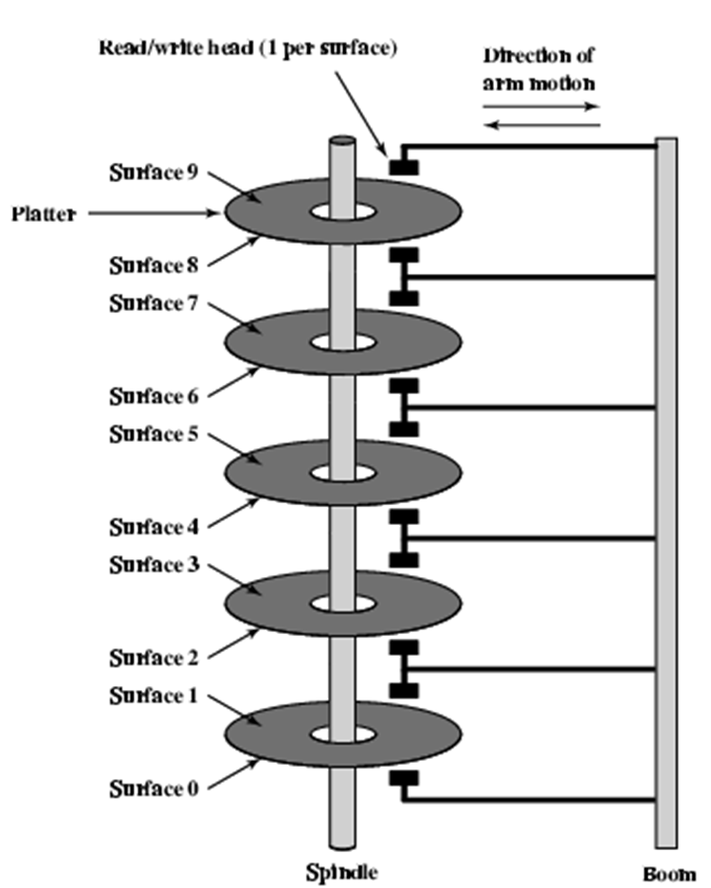
HARD DISKS/DISK DRIVES (FIXED) CONTD.

Slide 26
SPEED/ ACCESS TIME
Seek time: time taken by head to move to a specific track
Latency/Rotational delay: time required to spin the desired sector under the head.
Transfer time: time taken to transfer data.
Access time=seek time + latency+ transfer time

Slide 27
OPTICAL STORAGE
Use lasers to record (write), and also to read.
Record: high-powered laser burns pits into reflective coating.
Read: weaker laser reads pits; differences in reflectance of pits & lands interpreted as 0 and 1. (See textbook figures)
For PCs: ~650 MB per CD-ROM (275,000 pgs of text)
Similar to audio CDs, but more error-correction.
Internal & external drives.

Slide 28
MAIN MEMORY
The main memory is the central storage unit in a computer system.
It is a relatively large and fast memory used to store programs and data during the computer operation
The principal technology used for the main memory is based on semiconductor integrated circuits
Random-Access Memory (RAM)
Integrated circuit RAM chips are available in two possible operating modes, static and dynamic.

Slide 29
RAM
The static RAM consists essentially of internal flip-flops that store the binary information.
The stored information remains valid as long as power is applied to the unit.
The dynamic RAM stores the binary information in the form of electric charges that are applied to capacitors.
The capacitors are provided inside the chip by MOS transistors. the capacitors must be periodically recharged by refreshing the dynamic memory.
The dynamic RAM offers reduced power consumption and larger storage capacity in a single memory chip.
The static RAM is easier to use and has shorter read and write cycles.

Slide 30
ROM
Most of the main memory in a general-purpose computer is made up of RAM integrated circuit chips, but a portion of the memory may be constructed with ROM chips.
Originally, RAM was used to refer to a random-access memory, but now it is used to designate a read/write memory to distinguish it from a read-only memory, although ROM is also random access.
RAM is used for storing the bulk of the programs and data that are subject to change.
ROM is used for storing programs that are permanently resident in the computer and for tables of constants that do not change in value once the production of the computer is completed

Slide 31
BOOTSTRAP LOADER
Among other things, the ROM portion of main memory is needed for storing an initial program called a bootstrap loader.
The bootstrap loader is a program whose function is to start the computer software operating when power is turned on. Since RAM is volatile, its contents are destroyed when power is turned off. The contents of ROM remain unchanged after power is turned off and on again.
The startup of a computer consists of turning the power on and starting the execution of an initial program. Thus when power is turned on, the hardware of the computer sets the program counter to the first address of the bootstrap loader.
The bootstrap program loads a portion of the operating system from disk to main memory and control is then transferred to the operating system, which prepares the computer for general use.
RAM and ROM chips are available in a variety of sizes. If the memory needed for the computer is larger than the capacity of one chip, it is necessary to combine a number of chips to form the required memory size.

Slide 32
RAM AND ROM CHIPS
A RAM chip is better suited for communication with the CPU if it has one or more control inputs, that select the chip only when needed.
Another common feature is a bidirectional data bus that allows the transfer of data either from memory to CPU during a read operation, or from CPU to memory during a write operation.
A bidirectional bus can be constructed with three-state buffers. A three-state buffer output can be placed in one of three possible states:
a signal equivalent to logic 1, a signal equivalent to logic 0, or a high impedance state.
The logic 1 and 0 are normal digital signals. The high impedance state behaves like an open circuit, which means that the output does not carry a signal and has no logic significance.

Slide 33

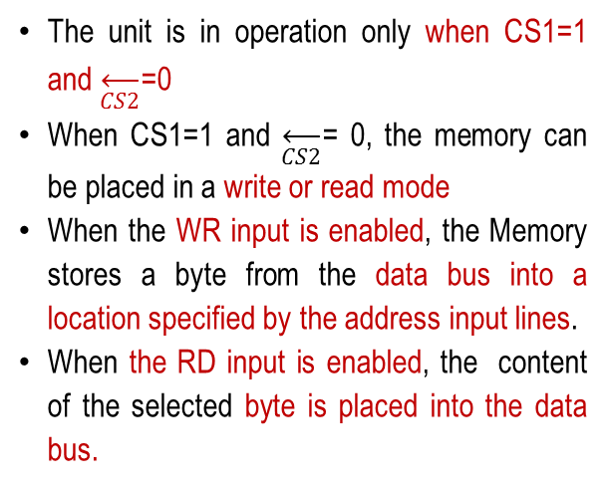
TYPICAL RAM CHIP:
The capacity of the memory is 128 words of eight bits (one byte) per word.
This requires a 7-bit address and an 8-bit bidirectional data bus.
BLOCK DIAGRAM
The read and write inputs specify the memory operation and the two chips select (CS) control inputs are enabling the chip only when it is selected by the microprocessor.
The read and write inputs are sometimes combined into one line labeled R/W.
Chip select 1
CS1
Chip select 2
CS2
Read
RD
128 x 8
8-bit data bus
RAM
Write
WR
7-bit address
AD 7
The unit is in operation only when CS1=1 and $\overset{←}{CS2}$=0
When CS1=1 and $\overset{←}{CS2}$= 0, the memory can be placed in a write or read mode
When the WR input is enabled, the Memory stores a byte from the data bus into a location specified by the address input lines.
When the RD input is enabled, the content of the selected byte is placed into the data bus.
FUNCTION TABLE

Slide 34
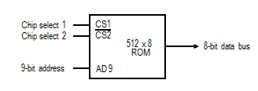
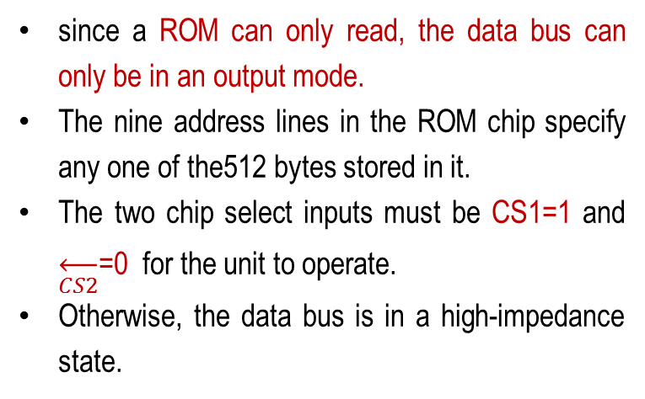
TYPICAL ROM CHIP
For the same-size chip, it is possible to have more bits of ROM than of RAM, because the internal binary cells in ROM occupy less space than in RAM.
For this reason, the diagram specifies a 512-byte ROM, while the RAM has only 128 bytes.
since a ROM can only read, the data bus can only be in an output mode.
The nine address lines in the ROM chip specify any one of the512 bytes stored in it.
The two chip select inputs must be CS1=1 and $\overset{←}{CS2}$=0 for the unit to operate.
Otherwise, the data bus is in a high-impedance state.

Slide 35
MEMORY ADDRESS MAP
The designer of a computer system must calculate the amount of memory required for the particular application and assign it to either RAM or ROM.
The interconnection between memory and processor is then established from knowledge of the size of memory needed and the type of RAM and ROM chips available.
The addressing of memory can be established by means of a table that specifies the memory address assigned to each chip.
The table, called a memory address map, is a pictorial representation of assigned address space for each chip in the system.

Slide 36
MEMORY ADDRESS MAP CONTD.
Hexa
address
Address bus
Component
10 9 8 7 6 5 4 3 2 1
RAM 1
RAM 2
RAM 3
RAM 4
ROM
0000 - 007F
0080 - 00FF
0100 - 017F
0180 - 01FF
0200 - 03FF
0 0 0 x x x x x x x
0 0 1 x x x x x x x
0 1 0 x x x x x x x
0 1 1 x x x x x x x
1 x x x x x x x x x
16 | 15 | 14 | 13 | 12 | 11 | 10 | 9 | 8 | 7 | 6 | 5 | 4 | 3 | 2 | 1
RAM 1
0 | 0 | 0 | 0 | 0 | 0 | 0 | 0 | 0 | 0 | 0 | 0 | 0 | 0 | 0 | 0
0 | 0 | 0 | 0
0 | 0 | 0 | 0 | 0 | 0 | 0 | 0 | 0 | 1 | 1 | 1 | 1 | 1 | 1 | 1
0 | 0 | 7 | F

Slide 37
MEMORY ADDRESS MAP CONTD.
The component column specifies whether a RAM or a ROM chip is used.
The hexadecimal address column assigns a range of hexadecimal equivalent addresses for each chip.
The address bus lines are listed in the third column.
The RAM chips have 128 bytes and need seven address lines.
The ROM chip has 512 bytes and needs 9 address lines.
Although there are 16 lines in the address bus, the table shows only 10 lines because the other 6 are not used in this example and are assumed to be zero.

Slide 38
MEMORY ADDRESS MAP CONTD.
Hexa
address
Address bus
Component
10 9 8 7 6 5 4 3 2 1
RAM 1
RAM 2
RAM 3
RAM 4
ROM
0000 - 007F
0080 - 00FF
0100 - 017F
0180 - 01FF
0200 - 03FF
0 0 0 x x x x x x x
0 0 1 x x x x x x x
0 1 0 x x x x x x x
0 1 1 x x x x x x x
1 x x x x x x x x x
The small x's under the address bus lines designate those lines that must be connected to the address inputs in each chip.
The x's are always assigned to the low-order bus lines: lines 1 through 7 for the RAM and lines 1 through 9 for the ROM.
It is now necessary to distinguish between four RAM chips by assigning to each a different address. For this particular example we choose bus lines 8 and 9 to represent four distinct binary combinations.
Note that any other pair of unused bus lines can be chosen for this purpose. The table clearly shows that the nine low-order bus lines constitute a memory space for RAM equal to 2⁹ = 512 bytes.
The distinction between a RAM and ROM address is done with another bus line. Here we choose line 10 for this purpose. When line 10 is 0, the CPU selects a RAM, and when this line is equal to 1, it selects the ROM.

Slide 39
CONNECTION OF MEMORY TO CPU
1 0
0 0
CPU
Address bus
16-11
10
9
8
7-1
RD
WR
Data bus
10 | 9 | 8 | 7 | 6 | 5 | 4 | 3 | 2 | 1
Decoder
3
2
1
0
RAM
CS1
CS2
128 x 8
Data
RD
RAM 1
WR
AD7
ROM
CS1
CS2
128 x 8
Data
Distinction between a RAM and ROM address
RD
RAM 2
WR
AD7
CS1
CS2
128 x 8
Data
Distinguish between four RAM chips
RD
RAM 3
WR
AD7
CS1
CS2
128 x 8
RD
RAM 4
Data
WR
AD7
CS1
1- 7
CS2
512 x 8
8
ROM
Data
9
AD9

Slide 40
ASSOCIATIVE MEMORY
Many data-processing applications require the search of items in a table stored in memory
The number of accesses to memory depends on the location of the item and the efficiency of the search algorithm.
Many search algorithms have been developed to minimize the number of accesses while searching for an item in a random or sequential access memory.
The time required to find an item stored in memory can be reduced considerably if stored data can be identified for access by the content of the data itself rather than by an address.
A memory unit accessed by content is called an associative memory or content addressable memory (CAM).

Slide 41
ASSOCIATIVE MEMORY CONTD.
When a word is written in an associative memory, no address is given. The memory is capable of finding an empty unused location to store the word.
When a word is to be read from an associative memory, the content of the word, or part of the word, is specified.
The memory locates all words which match the specified content and marks them for reading.
An associative memory is more expensive than a random access memory because each cell must have storage capability as well as logic circuits for matching its content with an external argument.
For this reason, associative memories are used in applications where the search time is very critical and must be very short.

Slide 42
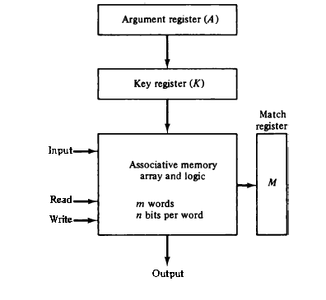
BLOCK DIAGRAM OF ASSOCIATIVE MEMORY
It consists of a memory array and logic for m words with n bits per word.
The argument register A and key register K each have n bits, one for each bit of a word.
The match register M has m bits, one for each memory word.
Each word in memory is compared in parallel with the content of the argument register.
The words that match the bits of the argument register set a corresponding bit in the match register.
After the matching process, those bits in the match register that have been set indicate the fact that their corresponding words have been matched.
Reading is accomplished by a sequential access to memory for those words whose corresponding bits in the match register have been set.

Slide 43
BLOCK DIAGRAM OF ASSOCIATIVE MEMORY CONTD.
The key register provides a mask for choosing a particular field or key in the argument word.
The entire argument is compared with each memory word if the key register contains all l' s.
Otherwise, only those bits in the argument that have l's in their corresponding position of the key register are compared.
Thus the key provides a mask or identifying piece of information which specifies how the reference to memory is made.
To illustrate with a numerical example, suppose that the argument register A and the key register K have the bit configuration shown below. Only the three leftmost bits of A are compared with memory words because K has 1's in these positions.
A 1 0 1 1 1 1 1 0 0
K 1 1 1 0 0 0 0 0 0
Word 1 1 0 0 1 1 1 1 0 0 no match
Word 2 1 0 1 0 0 0 0 0 1 match
Word2 matches the unmasked argument field because the three leftmost bits of the argument and the word are equal.

Slide 44
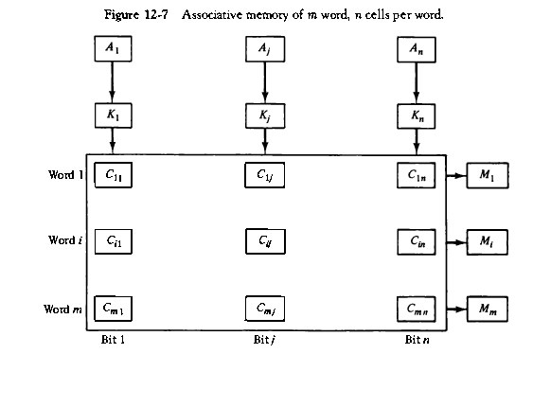
ASSOCIATIVE MEMORY OF m WORD, n CELLS PER WORD
The relation between the memory array and external registers in an associative memory is shown in Figure
The cells in the array are marked by the letter C with two subcripts. The first subscript gives the word number and the second specifies the bit position in the word.
Thus cell C_{ij} is the cell for bit j in word i. A bit Aj in the argument register is compared with all the bits in column j of the array provided that Kj = 1.
This is done for all columns j = 1, 2, . . . , n. If a match occurs between all the unmasked bits of the argument and the bits in word i, the corresponding bit M1 in the match register is set to 1.
If one or more unmasked bits of the argument and the word do not match, M1 is cleared to 0.
1
0
1
1
1
kj
0
k1
M1=0
0
1
0
Mi=0
1
1
1
Mn=1
1
0
0

Slide 45
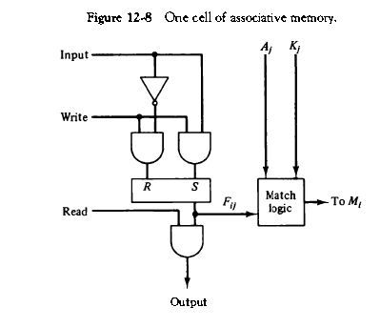
ONE CELL OF ASSOCIATIVE MEMORY
The internal organization of a typical cell C_{ij} is shown in Fig.
It consists of a flip-flop storage element F_{ij} and the circuits for reading, writing, and matching the cell.
The input bit is transferred into the storage cell during a write operation. The bit stored is read out during a read operation.
The match logic compares the content of the storage cell with the corresponding unmasked bit of the argument and provides an output for the decision logic that sets the bit in M, .
0
1
1
0
1
1
0
1
1
0
1
0
1
0
0

Slide 46
MATCH LOGIC
The match logic for each word can be derived from the comparison algorithm for two binary numbers.
First, we neglect the key bits and compare the argument in A with the bits stored in the cells of the words.
Word i is equal to the argument in A if Aj = Fij for j = 1, 2, . . . , n .
Two bits are equal if they are both 1 or both 0. The equality of two bits can be expressed logically by the Boolean function
If A₁=1 F₁₁=1
x₁=1*1 + 0*0 =1
If A₁=0 F₁₁=1
x₁=0*1 + 1*0 =0
where x_{j}= 1 if the pair of bits in position j are equal; otherwise x_{j} = 0.
For a word i to be equal to the argument in A we must have all x_{j} variables equal to 1.
This is the condition for setting the corresponding match bit M, to 1. The Boolean function for this condition is

Slide 47

MATCH LOGIC CONTD.
We now include the key bit K_{j} in the comparison logic.
The requirement is that if K_{j} = 0, the corresponding bits of Aj and Fij need no comparison.
Only when K_{j} = 1 they must be compared.
This requirement is achieved by ORing each term with K’_{j} , thus
When K_{j} = 1, we have K’_{j} = 0 and x_{j} + 0 = x_{j}. When K_{j} = 0, then K’_{j} = 1 and x_{j} + 1 = 1.
A term (x_{j} + K’_{j} ) will be in the 1 state if its pair of bits is not compared.
The match logic for word i in an associative memory can now be expressed by the following Boolean function:
Each term in the expression will be equal to 1 if its corresponding K_{j} = 0.
If K_{j} = 1, the term will be either 0 or 1 depending on the value of x_{j}.
A match will occur and Mi will be equal to 1 if all terms are equal to 1 .

Slide 48
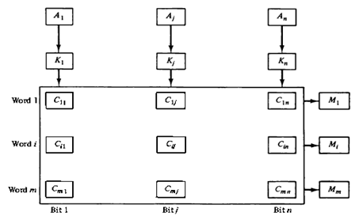

MATCH LOGIC CONTD.
A ₁
K’₁
F ₁₁
If we substitute the original definition of xj, the Boolean function above can be expressed as follows:
x1
where π is a product symbol designating the AND operation of all n terms. We need m such functions, one for each word i = 1, 2, 3, . . . , m .

Slide 49
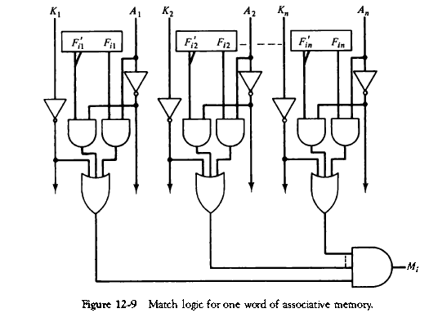
MATCH LOGIC FOR ONE WORD OF ASSOCIATIVE MEMORY
Each cell requires two AND gates and one OR gate
The inverters for Aj and Kj are needed once for each column and are used for all bits in the column.
The output of all OR gates in the cells of the same word go to the input of a common AND gate to generate the match signal for Mi.
Mi will be logic 1 if a match occurs and 0 if no match occurs.
If the key register contains all 0’s , output Mi will be a 1 irrespective of the value of A or the word. This occurrence must be avoided during normal operation

Slide 50
MATCH LOGIC FOR ONE WORD OF ASSOCIATIVE MEMORY
In most applications, the associative memory stores a table with no two identical items‘ under a given key.
In this case, only one word may match the unmasked argument field.
By connecting output M; directly to the read line in the same word position (instead of the M register), the content of the matched word will be presented automatically at the output lines and no special read command signal is needed.

Slide 51
CACHE MEMORY
If the active portions of the program and data are placed in a fast small memory, the average memory access time can be reduced, thus reducing the total execution time of the program.
Such a fast small memory is referred to as a cache memory.
It is placed between the CPU and main memory.
The cache memory access time is less than the access time of main memory by a factor of 5 to 10.
The cache is the fastest component in the memory hierarchy and approaches the speed of CPU components.
Although the cache is only a small fraction of the size of main memory, a large fraction of memory requests will be found in the fast cache memory because of the locality of reference property of programs.

Slide 52
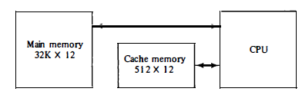
CACHE OPERATION
The basic operation of the cache is as follows.
When the CPU needs to access memory, the cache is examined.
If the word is found in the cache, it is read from the fast memory.
If the word addressed by the CPU is not found in the cache, the main memory is accessed to read the word.
A block of words containing the one just accessed is then transferred from main memory to cache memory.
The block size may vary from one word (the one just accessed) to about 16 words adjacent to the one just accessed.

Slide 53
HIT AND MISS
The performance of cache memory is frequently measured in terms of a quantity called hit ratio .
When the CPU refers to memory and finds the word in cache, it is said to produce a hit .
If the word is not found in cache, it is in main memory and it counts as a miss .
The ratio of the number of hits divided by the total CPU references to memory (hits plus misses) is the hit ratio.
The hit ratio is best measured experimentally by running representative programs in the computer and measuring the number of hits and misses during a given interval of time.

Slide 54
MAPPING
The basic characteristic of cache memory is its fast access time.
Therefore, very little or no time must be wasted when searching for words in the cache.
The transformation of data from main memory to cache memory is referred to as a mapping process.
Three types of mapping procedures are of practical interest when considering the organization of cache memory:
Associative mapping
Direct mapping
Set-associative mapping

Slide 55
EXAMPLE OF CACHE MEMORY
The transformation of data from main memory to cache memory is referred to as a mapping process.

Slide 56
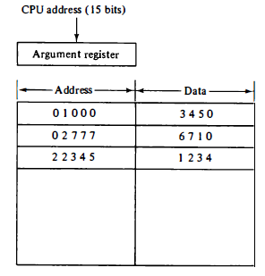
ASSOCIATIVE MAPPING
The associative memory stores both the address and content (data) of the memory word.
This permits any location in cache to store any word from main memory.
The diagram shows three words presently stored in the cache.
The address value of 15 bits is shown as a five-digit octal number and its corresponding 12 -bit word is shown as a four-digit octal number.
A CPU address of 15 bits is placed in the argument register and the associative memory is searched for a matching address.

Slide 57
ASSOCIATIVE MAPPING CONTD.
If the address is found, the corresponding 12-bit data is read and sent to the CPU.
If no match occurs, the main memory is accessed for the word.
The address--data pair is then transferred to the associative cache memory.
If the cache is full, an address--data pair must be displaced to make room for a pair that is needed and not presently in the cache.
The decision as to what pair is replaced is determined from the replacement algorithm that the designer chooses for the cache.
A simple procedure is to replace cells of the cache in round-robin order whenever a new word is requested from main memory.
This constitutes a first-in first-out (FIFO) replacement policy.

Slide 58
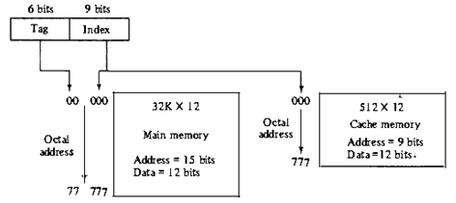
DIRECT MAPPING
Addressing relationships between main and cache memories
The CPU address of 15 bits is divided into two fields.
The nine least significant bits constitute the index field and the remaining six bits form the tag field.
The figure shows that main memory needs an address that includes both the tag and the index bits.
The number of bits in the index field is equal to the number of address bits required to access the cache memory.

Slide 59
DIRECT MAPPING CONTD.
In the general case, there are 2^{k} words in cache memory and 2^{n} words in main memory.
The n-bit memory address is divided into two fields: k bits for the index field and n - k bits for the tag field.
The direct mapping cache organization uses the n-bit address to access the main memory and the k-bit index to access the cache.
The disadvantage of direct mapping is that the hit ratio can drop considerably if two or more words whose addresses have the same index but different tags are accessed repeatedly.
However, this possibility is minimized by the fact that such words are relatively far apart in the address range (multiples of 512 locations in this example. )

Slide 60
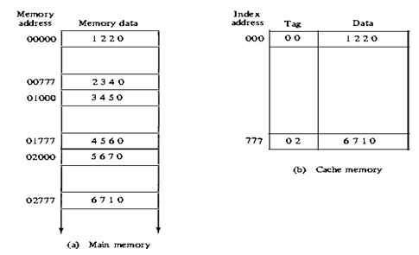
DIRECT MAPPING CACHE ORGANIZATION
The word at address zero is presently stored in the cache (index = 000, tag = 00, data = 1220).
Suppose that the CPU now wants to access the word at address 02000.
The index address is 000, so it is used to access the cache.
The two tags are then compared. The cache tag is 00 but the address tag is 02, which does not produce a match.
Therefore, the main memory is accessed and the data word 5670 is transferred to the CPU.
The cache word at index address 000 is then replaced with a tag of 02 and data of 5670

Slide 61
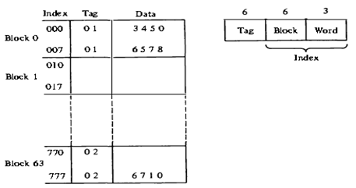
DIRECT MAPPING WITH BLOCK SIZE 8
The index field is now divided into two parts: the block field and the word field.
In a 512-word cache there are 64 blocks of 8 words each, since 64 x 8 = 512.
The block number is specified with a 6-bit field and the word within the block is specified with a 3-bit field.
The tag field stored within the cache is common to all eight words of the same block.
Every time a miss occurs, an entire block of eight words must be transferred from main memory to cache memory.
Although this takes extra time, the hit ratio will most likely improve with a larger block size because of the sequential nature of computer programs

Slide 62
Set-Associative Mapping
It was mentioned previously that the disadvantage of direct mapping is that two words with the same index in their address but with different tag values cannot reside in cache memory at the same time. A third type of cache organization, called set-associative mapping, is an improvement over the direct mapping organization in that each word of cache can store two or more words of memory under the same index address.

Slide 63
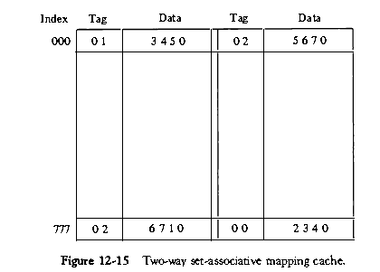

Slide 64
The words stored at addresses 01000 and 02000 of main memory are stored in cache memory at index address 000. Similarly, the words at addresses 02777 and 00777 are stored in cache at index address 777.
When the CPU generates a memory request, the index value of the address is used to access the cache. The tag field of the CPU address is then compared with both tags in the cache to determine if a match occurs. The comparison logic is done by an associative search of the tags in the set similar to an associative memory search: thus the name "set-associative." The hit ratio will improve as the set size increases because more words with the same index but different tags can reside in cache. However, an increase in the set size increases the number of bits in words of cache and requires more complex comparison logic.

Slide 65
Writing into Cache
the operation is a write, there are two ways that the system can proceed.
The simplest and most commonly used procedure is to update main memory with every memory write operation, with cache memory being updated in parallel if it contains the word at the specified address. This is called the write-through method. This method has the advantage that main memory always contains the same data as the cache.
The second procedure is called the write-back method. In this method only the cache location is updated during a write operation. The location is then marked by a flag so that later when the word is removed from the cache it is copied into main memory. The reason for the write-back method is that during the time a word resides in the cache, it may be updated several times; however, as long as the word remains in the cache, it does not matter whether the copy in main memory is out of date, It is only when the word is displaced from the cache that an accurate copy need be rewritten into main memory

Slide 66
Virtual Memory
In a memory hierarchy system, programs and data are first stored in auxiliary memory. Portions of a program or data are brought into main memory as they are needed by the CPU.
Each address that is referenced by the CPU goes through an address mapping from the so-called virtual address to a physical address in main memory
Virtual memory is used to give programmers the illusion that they have a very large memory at their disposal, even though the computer actually has a relatively small main memory.
A virtual memory system provides a mechanism for translating program-generated addresses into correct main memory locations

Slide 67
Address Space and Memory Space
An address used by a programmer will be called a virtual address, and the set of such addresses the address space . An address in main memory is called a location or physical address . The set of such locations is called the memory space .
The address space is allowed to be larger than the memory space in computers with virtual memory.
consider a computer with a main-memory capacity of 32K words (K = 1024). Fifteen bits are needed to specify a physical address in· memory since 32K = 2¹⁵• Suppose that the computer has available auxiliary memory for storing 2²⁰ = 1024K words. Thus auxiliary memory has a capacity for storing information equivalent to the capacity of 32 main memories. Denoting the address space by N and the memory space by M, we then have for this example N = 1024K and M = 32K.

Slide 68
In our example, the address field of an instruction code will consist of 20 bits but physical memory addresses must be specified with only 15 bits. Thus CPU will reference instructions and data with a 20-bit address, but the information at this address must be taken from physical memory because access to auxiliary storage for individual words will be prohibitively long.

Slide 69
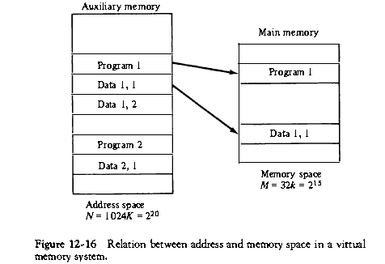

Slide 70
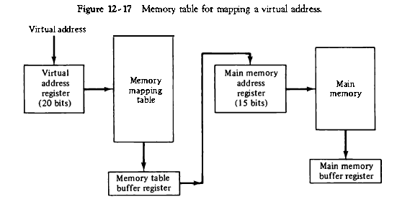
A table is then needed, as shown in Fig. 12-17, to map a virtual address of 20 bits to a physical address of 15 bits. The mapping is a dynamic operation,which means that every address is translated immediately as a word is referenced by CPU.

Slide 71
Address Mapping Using Pages
The physical memory is broken down into groups of equal size called blocks. The term page refers to groups of address space of the same size.
Although both a page and a block are split into groups of 1K words, a page refers to the organization of address space, while a block refers to the organization of memory space. The programs are also considered to be split into pages. Portions of programs are moved from auxiliary memory to main memory in records equal to the size of a page. The term "page frame" is sometimes used to denote a block.

Slide 72
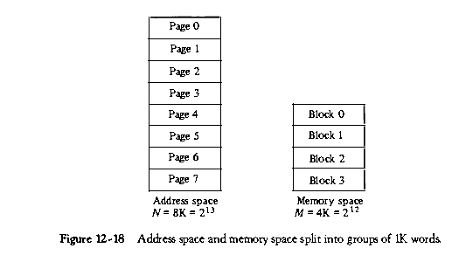

Slide 73
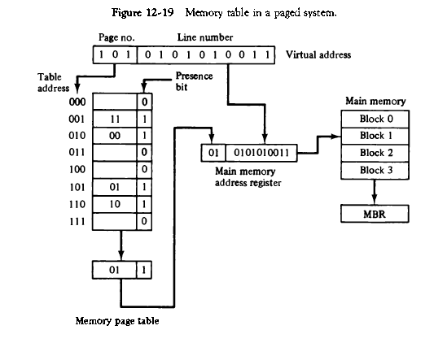

Slide 74
In the example of Fig. 12-18, a virtual address has 13 bits. Since each page consists of 2¹⁰ = 1024 words, the high order three bits of a virtual address will specify one of the eight pages and the low-order 10 bits give the line address within the page. Note that the line address in address space and memory space is the same; the only mapping required is from a page number to a block number.

Slide 75
The organization of the memory mapping table in a paged system is shown in Fig. 12-19. The memory-page table consists of eight words, one for each page. The address in the page table denotes the page number and the content of the word gives the block number where that page is stored in main memory. The table shows that pages 1, 2, 5, and 6 are now available in main memory in blocks 3, 0, 1, and 2, respectively. A presence bit in each location indicates whether the page has been transferred from auxiliary memory into main memory. A 0 in the presence bit indicates that this page is not available in main memory. The CPU references a word in memory with a virtual address of 13 bits. The three high-order bits of the virtual address specify a page number and also an address for the memory-page table. The content of the word in the memory page table at the page number address is read out into the memory table buffer register. If the presence bit is a 1, the block number thus read is transferred to the two high-order bits of the main memory address register. The line number from the virtual address is transferred into the 10 low-order bits of the memory address register. A read signal to main memory

Slide 76
Associative Memory Page Table
A more efficient way to organize the page table would be to construct it with a number of words equal to the number of blocks in main memory. In this way the size of the memory is reduced and each location is fully utilized. This method can be implemented by means of an associative memory with each word in memory containing a page number together with its corresponding block number. The page field in each word is compared with the page number in the virtual address. If a match occurs, the word is read from memory and its corresponding block number is extracted.

Slide 77
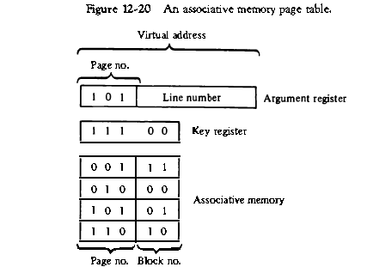

Slide 78


Slide 79
locality of reference property, which states that over a short interval of time, the addresses generated by a typical program refer to a few localized areas of memory repeatedly, while the remainder of memory is accessed relatively infrequently.
BACK

